Slide 1
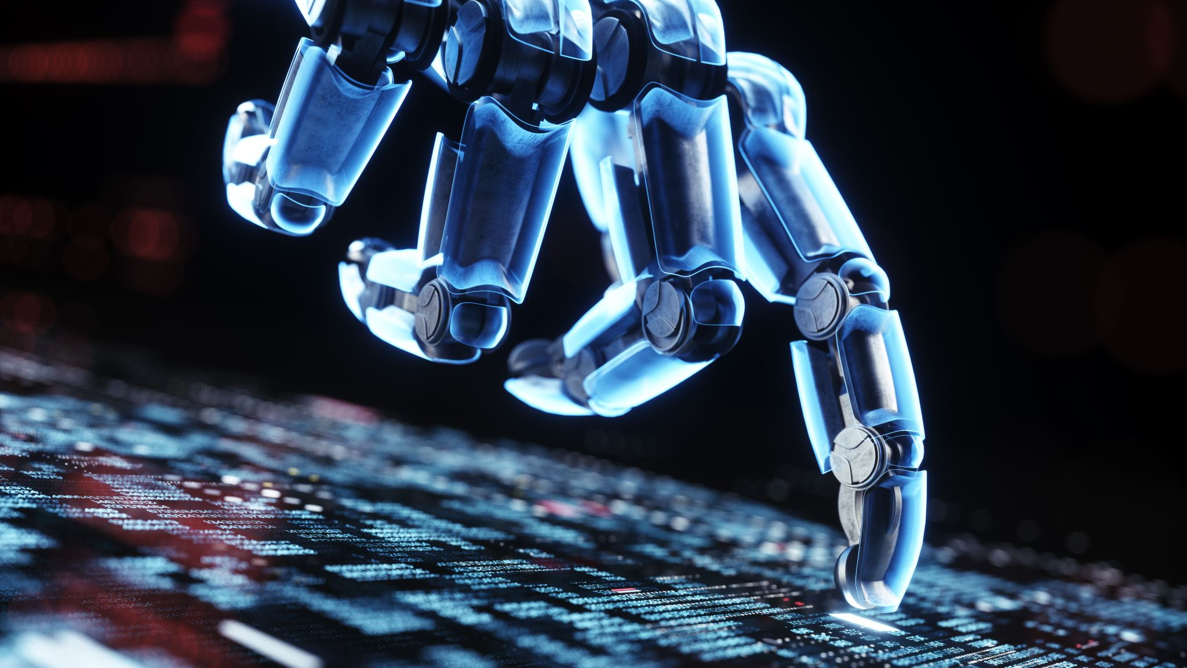
Artificial Intelligence & Machine Learning
Powering the Future of Technology

Slide 2


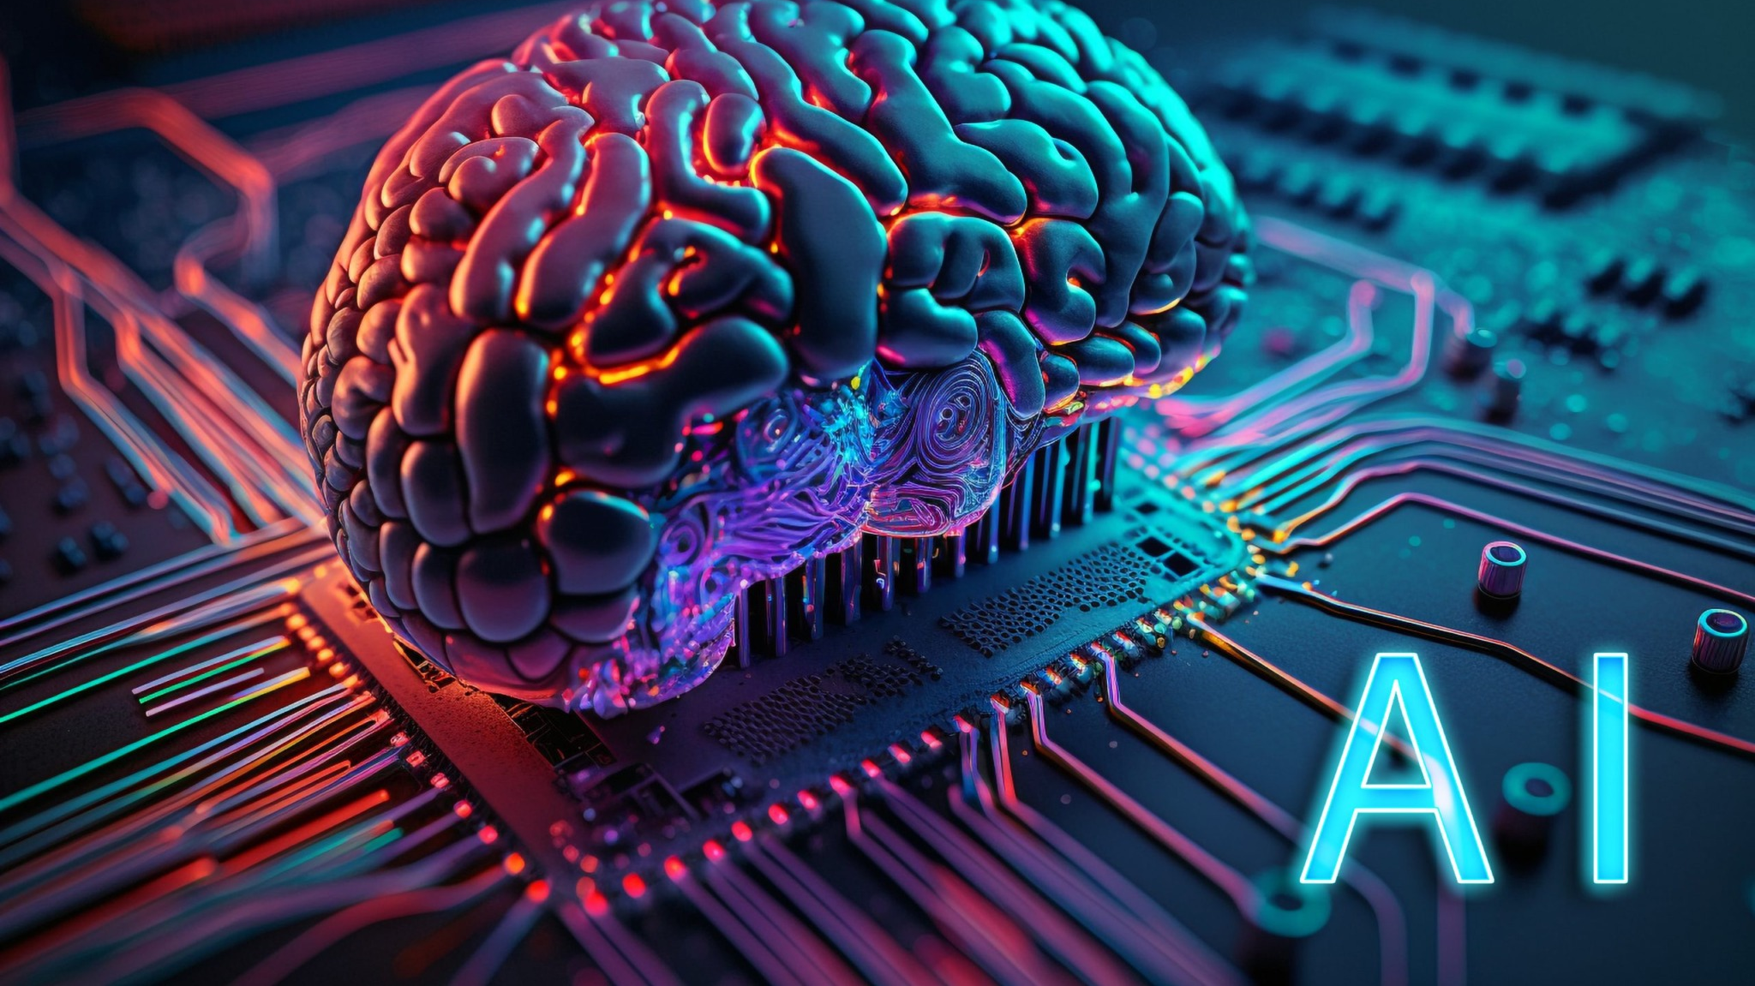
Artificial Intelligence is the ability of machines to perform tasks that normally require human intelligence
Examples include:
- Decision making
- Language understanding
- Visual recognition

Slide 3
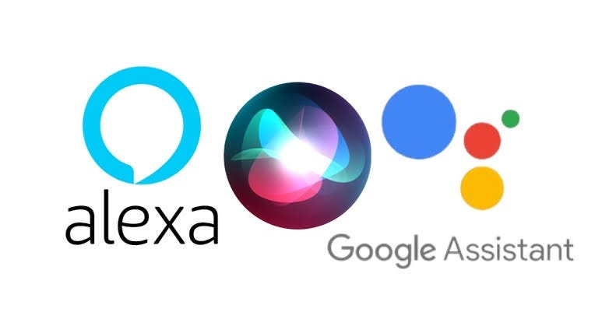

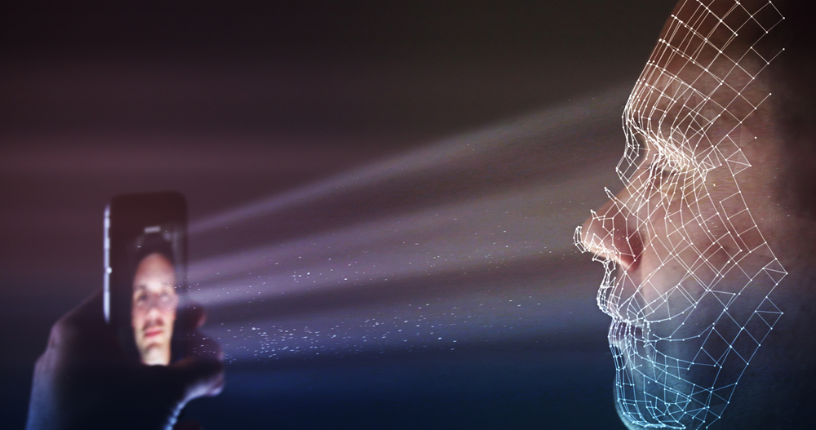
AI in Everyday Life
Voice Assistants
Recommendations
Face Recognition
Siri, Alexa, Google Assistant
Netflix, YouTube, Amazon
Phone unlock, Security apps

Slide 4
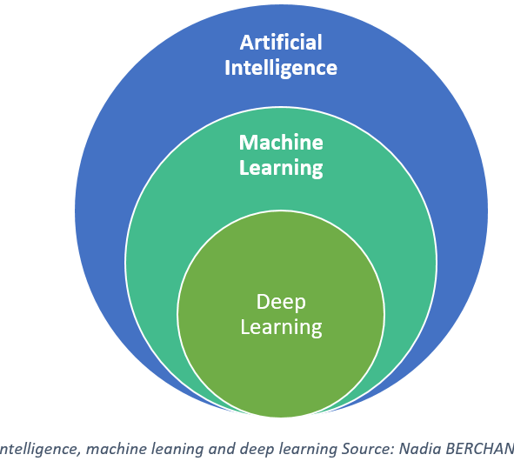
What is Machine Learning?
Machine Learning is a branch of Artificial Intelligence where computers learn from data and improve their performance without being explicitly programmed.

Slide 5
Types of Machine Learning
Supervised Learning
Unsupervised Learning
Reinforcement Learning
Learns from labeled data
Ex: Email Spam Detection
Finds patterns in unlabeled data
Ex: Customer Segmentation
Learns through trial and error
Ex: Self-driving Cars

Slide 6
Artificial Intelligence vs Machine Learning
Artificial Intelligence
Machine Learning
Machines that mimic human intelligence
Simulate human thinking and decision-making
Self-driving car making traffic decisions
Systems that learn from data
Enable machines to learn from experience
Email spam filter improving with usage

Slide 7

Applications of AI & ML
Healthcare – Predict diseases
Finance – Detect fraud
Retail – Product recommendations
Education – Personalized tutoring
Agriculture – Smart farming

Slide 8
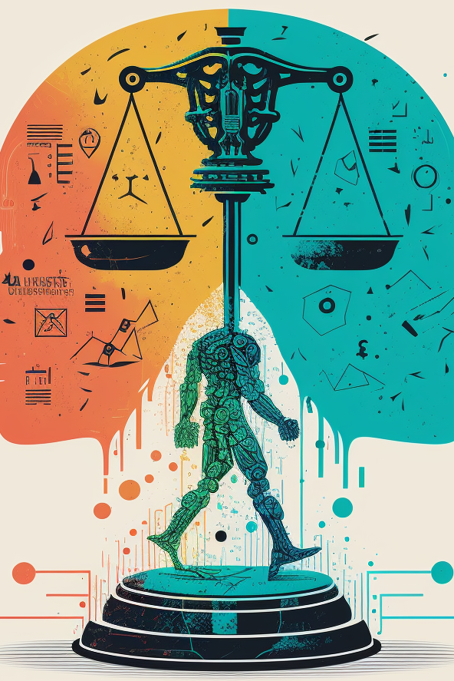
Challenges & Ethics in AI
🔒 Data Privacy – Sensitive data may be misused
⚖️ Bias in Algorithms – AI may favor one group over another
💼 Job Displacement – Automation may replace human jobs
🧠 Lack of Human Control – AI decisions may not be transparent
⚠️ Ethical Dilemmas – Who is responsible if AI causes harm?

Slide 9
Future of AI & ML
🤝 Human-AI Collaboration – Smart assistants in every field
🧠 General AI – Machines that think like humans
🏭 Fully Automated Industries – AI in factories, logistics, and delivery
🌐 AI for Social Good – Climate prediction, disaster response, healthcare in remote areas

Slide 10
Summary
✔️ AI simulates human intelligence in machines
✔️ ML enables systems to learn from data
✔️ Types of ML: Supervised, Unsupervised, Reinforcement
✔️ AI & ML are used in healthcare, finance, transport, etc.
✔️ Ethical issues like bias and data privacy are important
✔️ AI’s future includes full automation and human-AI collaboration

Slide 11
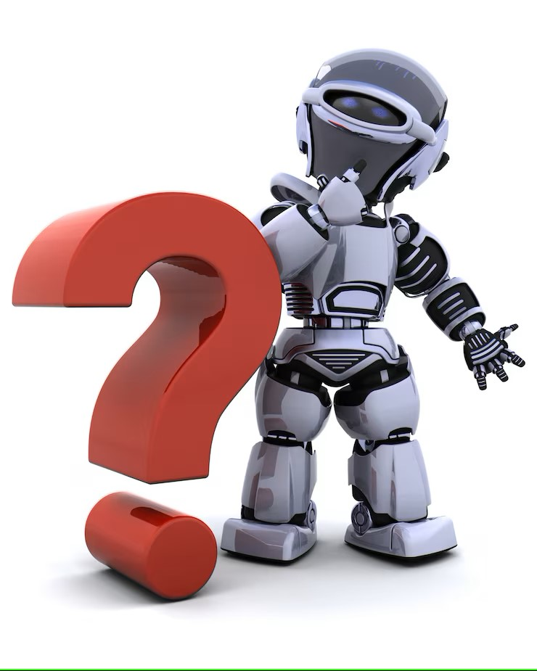
Any Questions?

Slide 12

Thank you

